Slide 1
Modified Y prediction
Y Prediction propagate MVs slower than 3DRS
Modified Y structure only cover 2/4 quarters
We need candidate structure have better coverage
T
T
S U
S U
S U
S U
T,
S U
T
S U
S U
S U
T
T
3DRS structure
Modified Y structure
First Iteration
Second Iteration

Slide 2
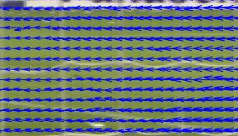
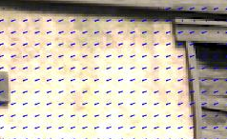
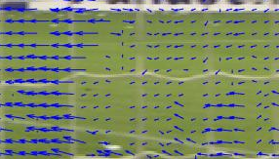
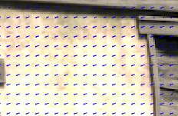
3DRS vs Y Prediction
3DRS has better convergence speed
Can be noticeable the differences in the first frame
Little differences when the result is converged
More important for sequences with global motion
Faster convergence for background area
3DRS
Y prediction
Global motion
Small lobal motion
Background area

Slide 3
New Candidate Structure
First iteration
Use 3 candidates from top line
Candidate from top line have better quality
They are from current iteration
Update candidates are generated for 2 best candidates
Temporal candidate provide a lookahead to convergence direction
Second iteration
The temporal candidate is move to current position
To preserve result of large motion MVs
The new candidate structure have better coverage
S U
S U
S
Z
T
S
S U
S U
T
First iteration
Second Iteration
S U
S U
S
T
S
S U
S U
T
Total candidates

Slide 4
Additional candidate structures
Others candidate structures used for comparison
Notation
(1) 3DRS
(2) Y prediction
(3) Modified Y Prediction
(4) Our structure
(5) (6) Two structures as above respectively
S
S U
S U
S
S
S U
S U
S
S
T
T
S
S U
S U
S
S
S
S U
S U
S
T
T
4 candidates from top line More complexity than ours
5 candidates from top line More complexity than ours

Slide 5
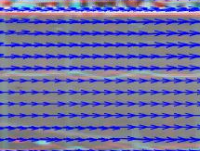
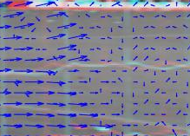
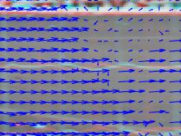
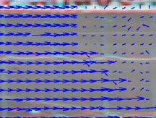
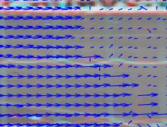
Structure comparison
Halo4_first frame (INIT)_First iteration
(1)
(2)
(3)
(4)
(5)
(6)

Slide 6
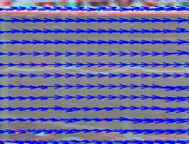
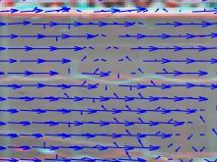
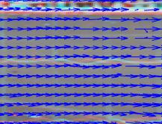
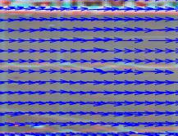
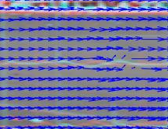
Structure comparison
Halo4_first frame (INIT)_Second iteration
(1)
(2)
(3)
(4)
(5)
(6)

Slide 7
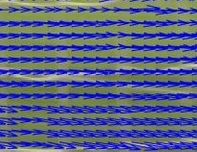
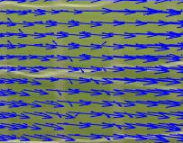
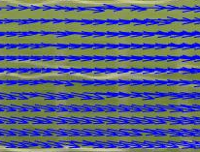
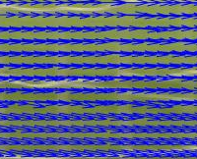
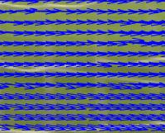
Structure comparison
Halo4_second frame
(1)
(2)
(3)
(4)
(5)
(6)

Slide 8
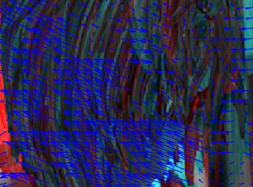
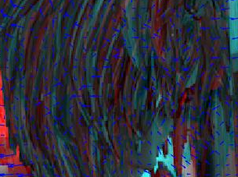
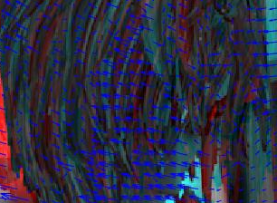
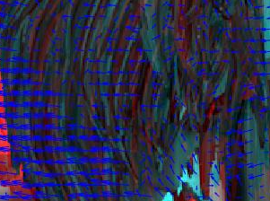
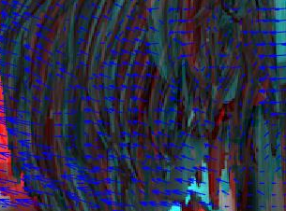
Structure comparison
Alley_1_first frame (INIT)_First iteration
(1)
(2)
(3)
(4)
(5)
(6)

Slide 9
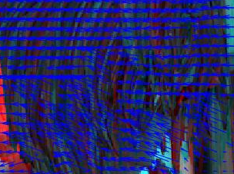
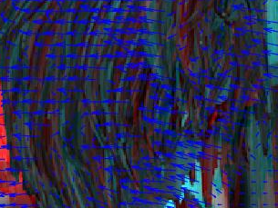
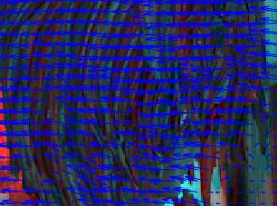
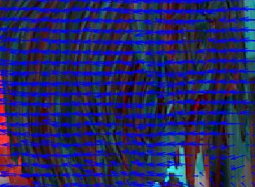
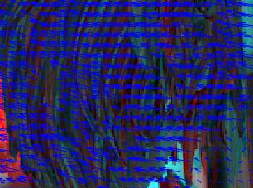
Structure comparison
Alley_1_first frame (INIT)_Second iteration
(1)
(2)
(3)
(4)
(5)
(6)

Slide 10
Structure comparison
Halo4 PSNR
Halo4 SSIM
Alley_1 PSNR
Alley_2 PSNR

Slide 11
Structure comparison
Interpolation result
Conclusion
Modified Y prediction (2) and (4) have worst results
3DRS (1) have best and stable result
Performance of our structure (3) and (5) (6) are close
 |  | 1 |  | 2 |  | 3 |  | 4 |  | 5 |  | 6
 |  | PSNR | SSIM | PSNR | SSIM | PSNR | SSIM | PSNR | SSIM | PSNR | SSIM | PSNR | SSIM
halo4 | 1st frame | 33.5373 | 0.89502 | 32.5449 | 0.83824 | 33.4571 | 0.88734 | 32.2343 | 0.81963 | 33.4103 | 0.88664 | 33.5099 | 0.89046
 | 2nd frame | 33.7568 | 0.90518 | 33.3732 | 0.88807 | 33.731 | 0.90282 | 32.815 | 0.85549 | 33.8028 | 0.90573 | 33.7434 | 0.90397
 | Average | 33.9883 | 0.90477 | 33.7077 | 0.89235 | 33.9775 | 0.90443 | 33.6375 | 0.88645 | 33.9762 | 0.90468 | 33.9785 | 0.90498
rimball | 1st frame | 37.1264 | 0.93798 | 36.9982 | 0.9363 | 37.0257 | 0.93745 | 37.0487 | 0.93704 | 37.0776 | 0.93772 | 37.0696 | 0.9373
 | 2nd frame | 40.6061 | 0.97342 | 40.7664 | 0.9735 | 40.7054 | 0.97343 | 40.6931 | 0.97302 | 40.6517 | 0.97317 | 40.7001 | 0.97338
 | Average | 38.8079 | 0.96041 | 38.8468 | 0.96047 | 38.8235 | 0.96089 | 38.8089 | 0.96041 | 38.8151 | 0.96046 | 38.8033 | 0.95979
alley_1 | 1st frame | 34.8134 | 0.89918 | 34.3025 | 0.87711 | 34.431 | 0.88491 | 34.228 | 0.87511 | 34.7254 | 0.89675 | 34.7561 | 0.89744
 | 2nd frame | 34.781 | 0.89882 | 34.6742 | 0.89316 | 34.7413 | 0.89735 | 34.7323 | 0.8948 | 34.8234 | 0.89912 | 34.8491 | 0.89919
 | Average | 34.4598 | 0.88809 | 34.2876 | 0.87843 | 34.4361 | 0.88628 | 34.3212 | 0.88105 | 34.5691 | 0.89096 | 34.5216 | 0.88874
alley_2 | 1st frame | 38.2697 | 0.95498 | 38.0482 | 0.95339 | 38.2184 | 0.95332 | 38.1861 | 0.95387 | 38.2439 | 0.95507 | 38.2916 | 0.95452
 | 2nd frame | 38.2944 | 0.95491 | 38.1405 | 0.95459 | 38.2661 | 0.95455 | 38.1704 | 0.95484 | 38.2 | 0.95459 | 38.2339 | 0.95487
 | Average | 38.2806 | 0.95248 | 38.1265 | 0.95151 | 38.2417 | 0.95168 | 38.1948 | 0.95167 | 38.2168 | 0.95148 | 38.2545 | 0.95234

Slide 12
MAP vs 3DRS
Computation complexity
MAP vs original 3DRS vs our version 3DRS
MAP use 3 level
Search range 16x8 at top level
Number of candidate per each block
MAP code also have many more algorithm
Occlusion detection and handling
Repetition pattern code
….
 |  | MAP | Our 3DRS | Original 3DRS
top level |  | 128
2nd level |  | 36
bottom level | normal block | 36 | 7 (first) + 6 (second) | 6 (first) + 6 (second)
 | large-motion block |  | 15 (first) + 6 (second)
Total |  | 53 | 13->21 | 12

Slide 13
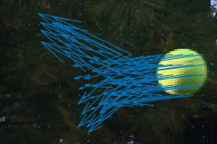
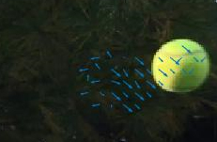
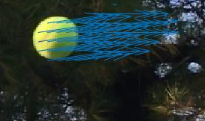
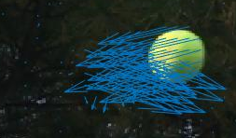
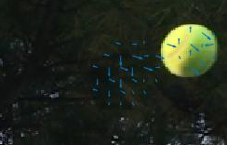
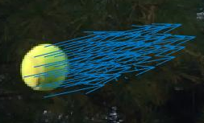

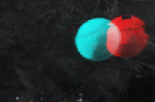
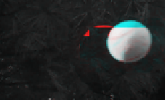
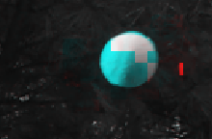
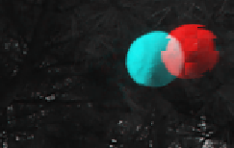

MAP vs 3DRS
Rimball
1st frame
2nd frame
1st frame
2nd frame
MAP
Original 3DRS (Y)
Our 3DRS

Slide 14
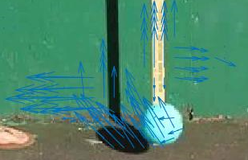
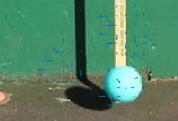
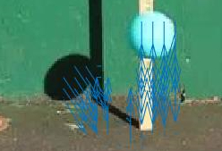
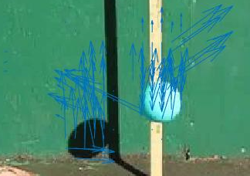
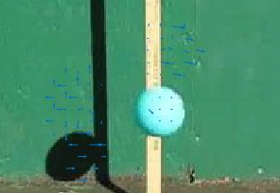
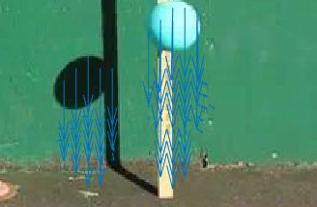
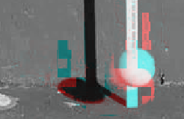
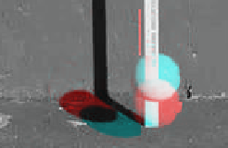
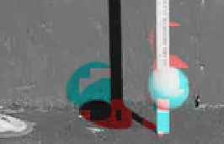
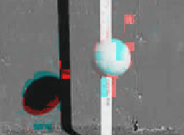
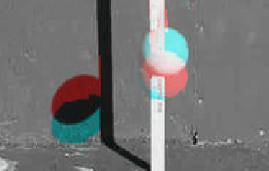

MAP vs 3DRS
Balldrop
1st frame
2nd frame
1st frame
2nd frame
MAP
Original 3DRS (Y)
Our 3DRS

Slide 15












MAP vs 3DRS
SoccerDrill3
Frame 48
Frame 50
Frame 48
Frame 50
MAP
Original 3DRS (Y)
Our 3DRS

Slide 16






MAP vs 3DRS
MAP result is noisy in flat area
SmallObject_Golf_4
SoccerDrill3
MAP
Original 3DRS (Y)
Our 3DRS

Slide 17
MAP vs 3DRS
Interpolation result
1: MAP 2: Original 3DRS (Y) 3: Our 3DRS
Average PSNR

Slide 18
MAP vs 3DRS
Interpolation result
Conclusion
Overall result: MAP > Our 3DRS > Original 3DRS (Y prediction)
However, MAP could be noisy in flat area
For large motion
Original 3DRS could not handle large motion
 | MAP |  | Original 3DRS (Y prediction) |  | Our 3DRS
 | PSNR | SSIM | PSNR | SSIM | PSNR | SSIM
Rimball | 32.457 | 0.96393 | 29.0706 | 0.96498 | 32.2825 | 0.96385
balldrop | 30.4751 | 0.98477 | 28.9913 | 0.9842 | 31.1768 | 0.989
soccerdrill1 | 28.6272 | 0.95322 | 26.7478 | 0.95056 | 27.2096 | 0.9631
soccerdrill3 | 27.7883 | 0.96456 | 25.1461 | 0.9628 | 26.6324 | 0.96524

